Slide 1
VELLORE MAPPING

Slide 2
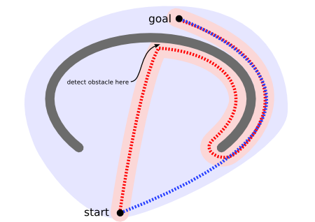
Need for efficient pathfinding?
Red path doesn’t scan and continues moving till it detects an obstacle. It, thereby, ends up taking a much larger path
Blue path scans the whole area ahead of time and detects an obstacle. So, it employs a much smaller path and saves time

Slide 3
Best Pathfinding Algorithms
There are few algorithms out there which are the most commonly used ones for pathfinding. These algorithms are used for their speed or/and efficiency in finding the shortest path.
Dijkstra’s Algorithm
Greedy Best-First-Search
A* Algorithm

Slide 4
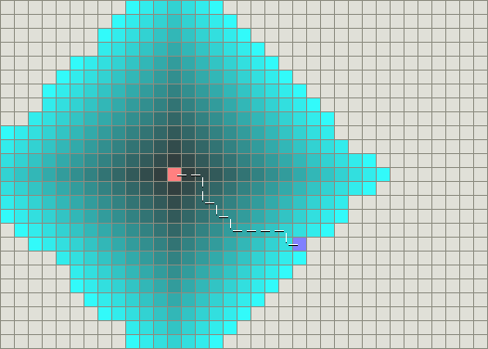
Dijkstra’s Algorithm
Works by visiting vertices in the graph starting with the object’s starting point
Examines the closest not yet examined vertex, adding its vertices to the set of vertices to be examined
Expands outwards from the starting point until it reaches the goal
Guaranteed to find the shortest path from the starting point to the goal

Slide 5
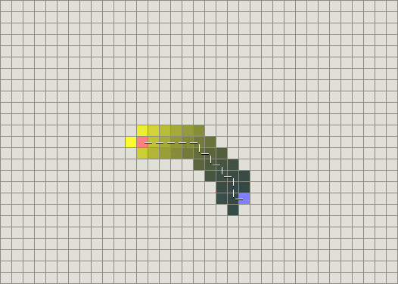
Greedy Best-First-Search
Uses an estimate called heuristic value
Selects the vertex closest to the goal
Not guaranteed to find the shortest path
Runs much quicker than Dijkstra’s algorithm because it uses the heuristic function to guide its way towards the goal

Slide 6
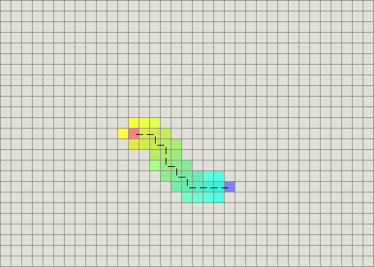
A* Algorithm
Most popular choice for pathfinding due to its flexibility
Combines best features of both Dijkstra’s and Greedy Best-First-Search Algorithm
Finds the shortest path possible while using a heuristic value to guide itself

Slide 7
Use of Heuristic Value
f = g + h
f : Cost Function
g : Distance from the starting point
h : Linear distance to the goal

Slide 8
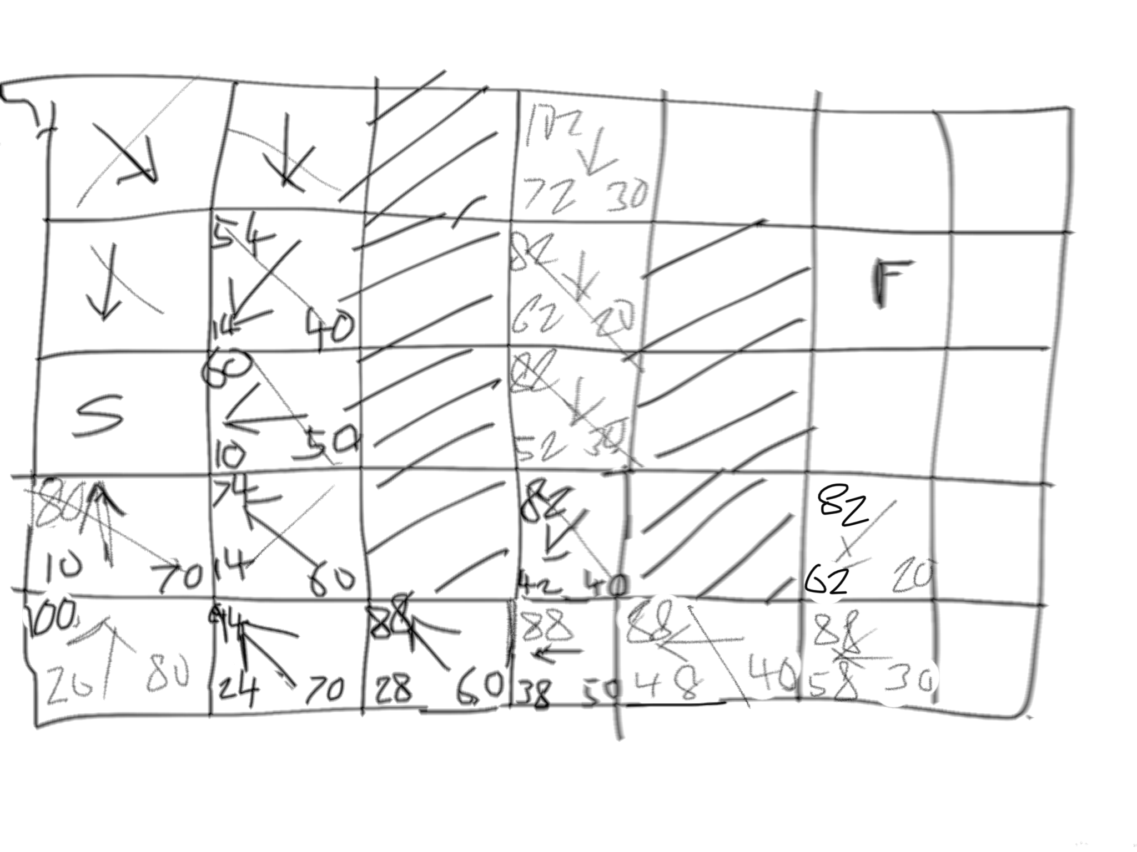

Slide 9
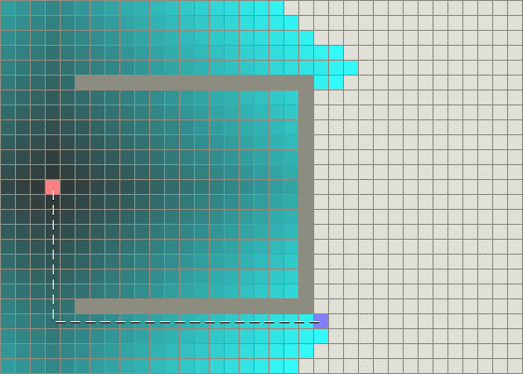
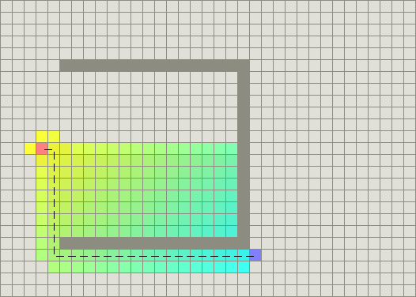
Area Mapped
Dijkstra’s Algorithm
A* Algorithm

Slide 10
OUR APPLICATION OF A* ALGORITHM

Slide 11
Our Map of Vellore
 |  |  |  |  |  |  |  | VIT
 |  |  |  |  |  |  | Ga.Ng. | Kang.
 |  |  |  |  | Vk.Ng. | Sa.Ng
 |  |  |  | Ma.Ng | CMC | Th.Ng.
 |  |  | Ba.Ng. | Ar.Rd.
 | Ma.Ng | Az. Rd. | RV. Rd.
Ka.Ng. |  | Mu.Ng
 | T-B Rd

Slide 12
How do we find the path?
Dividing the city into an array we mark the areas with traffic as obstacles
Areas with no/less traffic are used instead
Then we plot a path around these obstacles using A* Algorithm

